Slide 1
Link Analysis
Hongning Wang
CS@UVa

Slide 2
Recap: formula for Rocchio feedback
Standard operation in vector space
Parameters
Modified query
$${\vec{q}}_{m}=α\vec{q}+\frac{β}{|D_{r}|}\sum_{∀{\vec{d}}_{i}∈D_{r}}{{\vec{d}}_{i}}−\frac{γ}{|D_{n}|}\sum_{∀{\vec{d}}_{j}∈D_{n}}{{\vec{d}}_{j}}$$
Original query
Rel docs
Non-rel docs

Slide 3
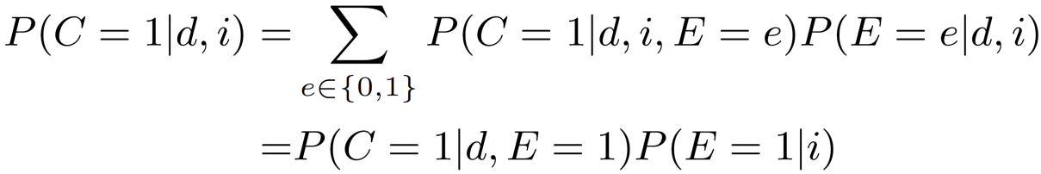
Recap: click models
Decompose relevance-driven clicks from position-driven clicks
Examine: user reads the displayed result
Click: user clicks on the displayed result
Atomic unit: (query, doc)
Prob.
(q,d₁)
(q,d₂)
Relevance quality
Pos.
Click probability
Examine probability
(q,d₃)
(q,d₄)
Notes:
A user clicks on a returned document if and only if that document has been examined by the user and it is relevant to the given query.

Slide 4
Structured v.s. unstructured data
Our claim before
IR v.s. DB = unstructured data v.s. structured data
As a result, we have assumed
Document = a sequence of words
Query = a short document
Corpus = a set of documents
However, this assumption is not accurate…

Slide 5
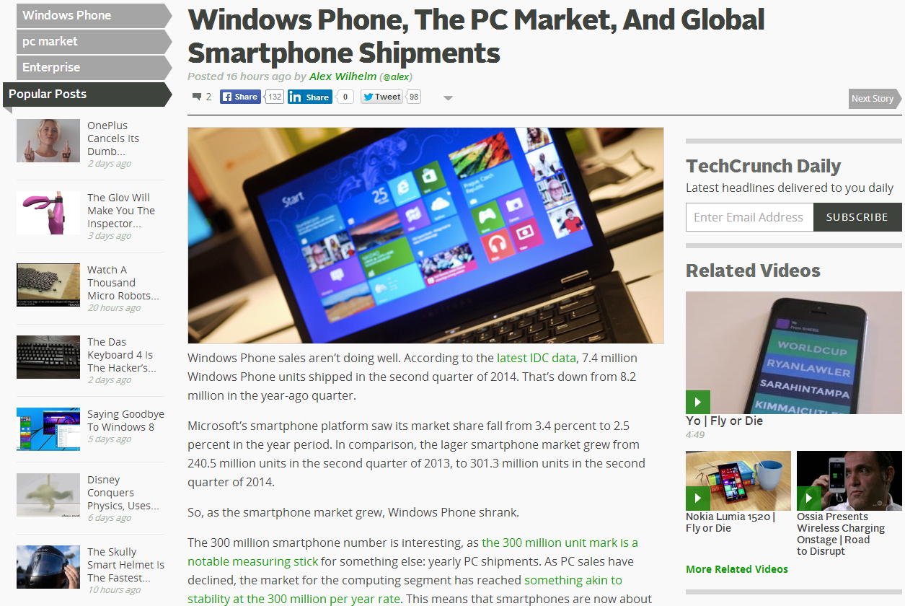
A typical web document has
Title
Anchor
Body

Slide 6
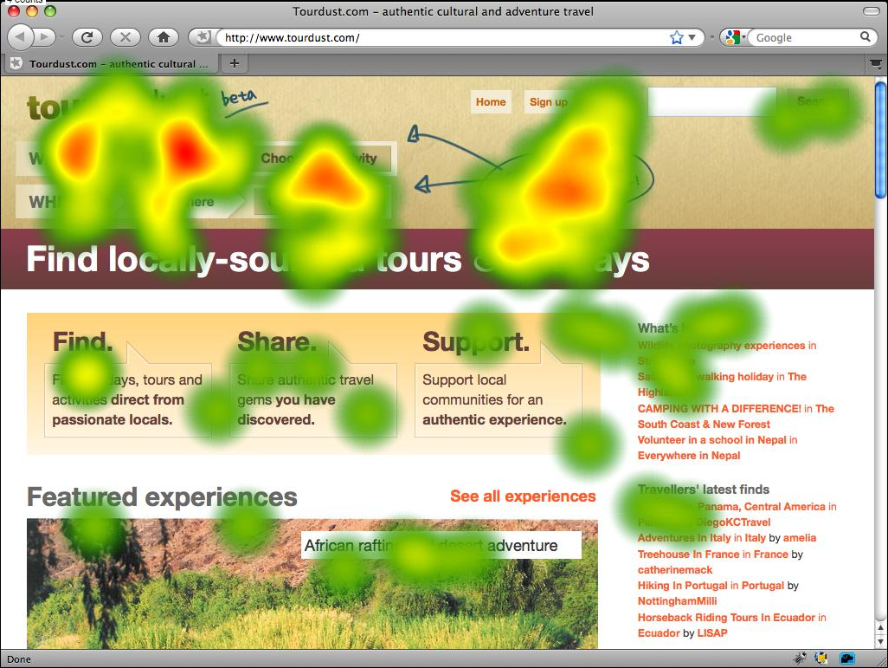
How does a human perceive a document’s structure

Slide 7
Intra-document structures
Document
Title
Concise summary of the document
Paragraph 1
Likely to be an abstract of the document
Paragraph 2
They might contribute differently for a document’s relevance!
…..
Images
Visual description of the document
Anchor texts
References to other documents

Slide 8
Exploring intra-document structures for retrieval
Document
Intuitively, we want to give different weights to the parts to reflect their importance
Title
In vector space model?
Weighted TF
Paragraph 1
Think about query-likelihood model…
Paragraph 2
Select D_{j} and generate a query word using D_{j}
…..
Anchor texts
“part selection” prob. Serves as weight for D_{j}
Can be estimated by EM or manually set

Slide 9
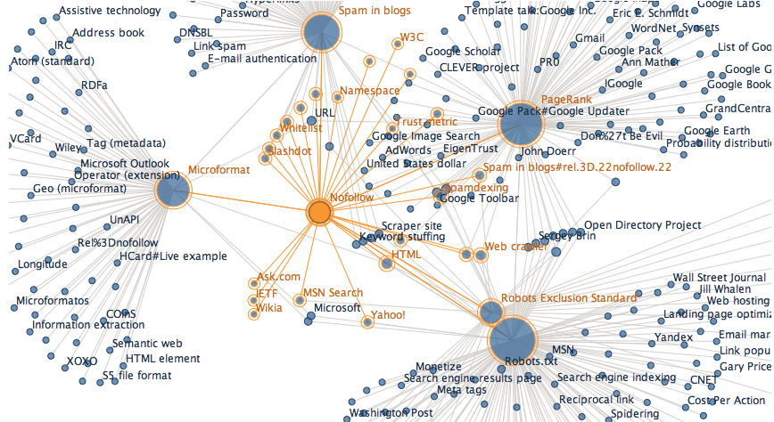
Inter-document structure
Documents are no longer independent
Source: https://wiki.digitalmethods.net/Dmi/WikipediaAnalysis

Slide 10
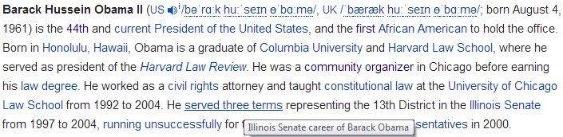
What do the links tell us?
Anchor
Rendered form
Original form

Slide 11
What do the links tell us?
Anchor text
How others describe the page
E.g., “big blue” is a nick name of IBM, but never found on IBM’s official web site
A good source for query expansion, or can be directly put into index

Slide 12
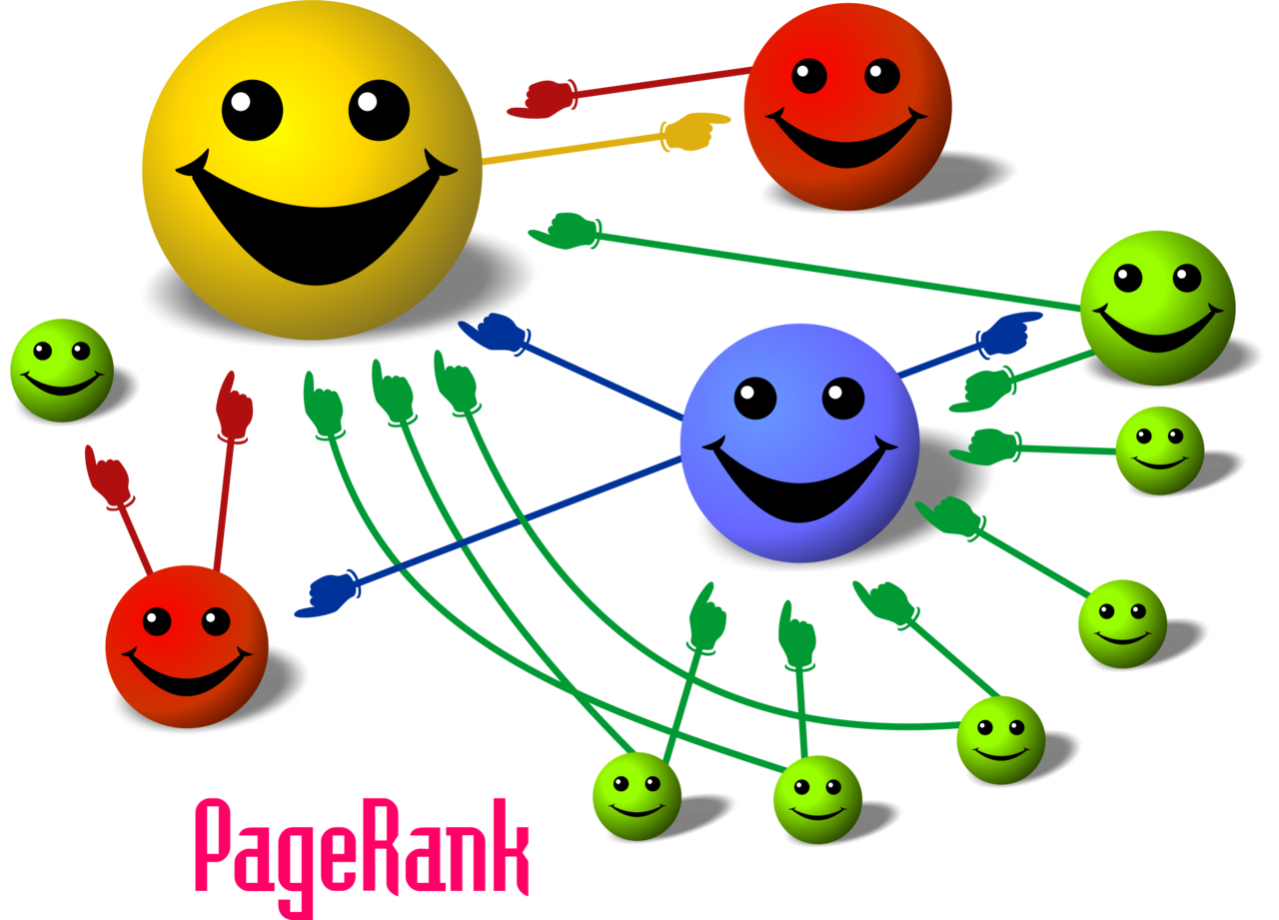

What do the links tell us?
Linkage relation
Endorsement from others – utility of the page
"PageRank-hi-res". Licensed under Creative Commons Attribution-Share Alike 2.5 via Wikimedia Commons - http://commons.wikimedia.org/wiki/File:PageRank-hi-res.png#mediaviewer/File:PageRank-hi-res.png

Slide 13
Analogy to citation network
Authors cite others’ work because
A conferral of authority
They appreciate the intellectual value in that paper
There is certain relationship between the papers
Bibliometrics
A citation is a vote for the usefulness of that paper
Citation count indicates the quality of the paper
E.g., # of in-links

Slide 14
Situation becomes more complicated in the web environment
Adding a hyperlink costs almost nothing
Taken advantage by web spammers
Large volume of machine-generated pages to artificially increase “in-links” of the target page
Fake or invisible links
We should not only consider the count of in-links, but the quality of each in-link
PageRank
HITS

Slide 15
Link structure analysis
Describes the characteristic of network structure
Reflect the utility of web documents in a general sense
An important factor when ranking documents
For learning-to-rank
For focused crawling

Slide 16
Recall how we do internet browsing
Mike types a URL address in his Chrome’s URL bar;
He browses the content of the page, and follows the link he is interested in;
When he feels the current page is not interesting or there is no link to follow, he types another URL and starts browsing from there;
He repeats 2 and 3 until he is tired or satisfied with this browsing activity

Slide 17
PageRank
A random surfing model of internet
A surfer begins at a random page on the web and starts random walk on the graph
On current page, the surfer uniformly follows an out-link to the next page
When there is no out-link, the surfer uniformly jumps to a page from the whole page
Keep doing Step 2 and 3 forever

Slide 18


PageRank
A measure of web page popularity
Probability of a random surfer who arrives at this web page
Only depends on the linkage structure of web pages
Transition matrix
d₁
$$M=\left(\begin{matrix}\begin{matrix}0 & 0 \\ 0 & 0\end{matrix} & \begin{matrix}0.5 & 0.5 \\ 0 & 0\end{matrix} \\ \begin{matrix}0 & 1 \\ 0.5 & 0.5\end{matrix} & \begin{matrix}0 & 0 \\ 0 & 0\end{matrix}\end{matrix}\right)$$
d₃
α: probability of random jump
N: # of pages
d₂
d₄
$$p_{t}\left(d\right)=αM^{T}p_{t−1}\left(d\right)+\frac{\left(1−α\right)}{N}p_{t−1}\left(d\right)$$
Random walk

Slide 19
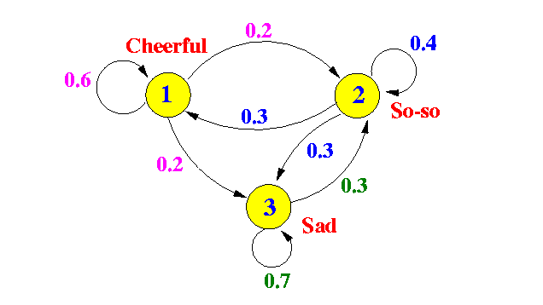
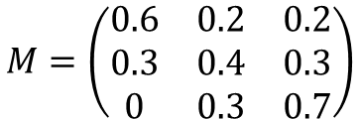
Theoretic model of PageRank
Markov chains
A discrete-time stochastic process
It occurs in a series of time-steps in each of which a random choice is made
Can be described by a directed graph or a transition matrix
P(So-so|Cheerful)=0.2
$$M=\left(\begin{matrix}0.6 & 0.2 & 0.2 \\ 0.3 & 0.4 & 0.3 \\ 0 & 0.3 & 0.7\end{matrix}\right)$$
A first-order Markov chain for emotion

Slide 20
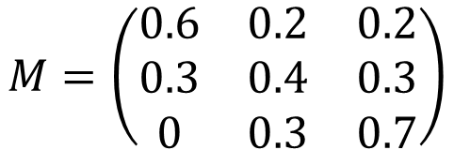
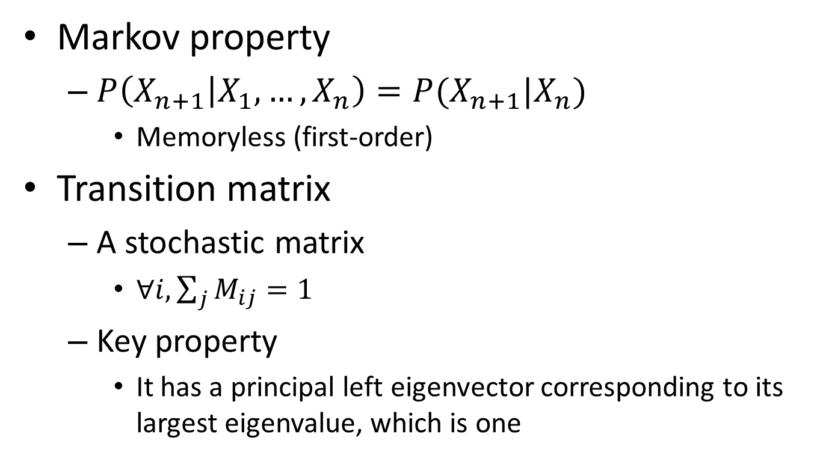
Markov chains
Markov property
$P\left(X_{n+1} | X_{1},…,X_{n}\right)=P(X_{n+1}|X_{n})$
Memoryless (first-order)
Transition matrix
A stochastic matrix
$∀i,\sum_{j}{M_{ij}=1}$
Key property
It has a principal left eigenvector corresponding to its largest eigenvalue, which is one
Idea of random surfing
$$M=\left(\begin{matrix}0.6 & 0.2 & 0.2 \\ 0.3 & 0.4 & 0.3 \\ 0 & 0.3 & 0.7\end{matrix}\right)$$
Mathematical interpretation of PageRank score

Slide 21
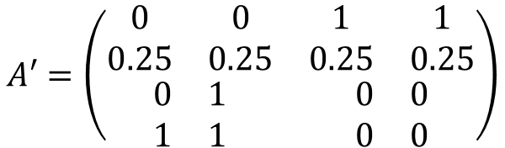

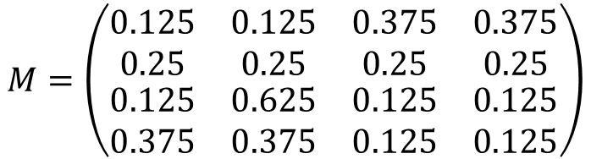

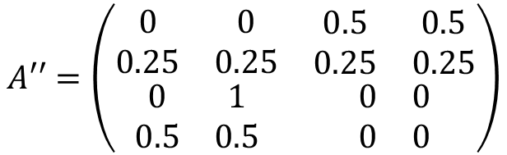
Theoretic model of PageRank
Transition matrix of a Markov chain for PageRank
1. Enable random jump on dead end
d₁
$$A=\left(\begin{matrix}\begin{matrix}0 & 0 \\ 0 & 0\end{matrix} & \begin{matrix}1 & 1 \\ 0 & 0\end{matrix} \\ \begin{matrix}0 & 1 \\ 1 & 1\end{matrix} & \begin{matrix}0 & 0 \\ 0 & 0\end{matrix}\end{matrix}\right)$$
$$A′=\left(\begin{matrix}\begin{matrix}0 & 0 \\ 0.25 & 0.25\end{matrix} & \begin{matrix}1 & 1 \\ 0.25 & 0.25\end{matrix} \\ \begin{matrix}0 & 1 \\ 1 & 1\end{matrix} & \begin{matrix}0 & 0 \\ 0 & 0\end{matrix}\end{matrix}\right)$$
d₃
d₂
2. Normalization
d₄
3. Enable random jump on all nodes
$$M=\left(\begin{matrix}\begin{matrix}0.125 & 0.125 \\ 0.25 & 0.25\end{matrix} & \begin{matrix}0.375 & 0.375 \\ 0.25 & 0.25\end{matrix} \\ \begin{matrix}0.125 & 0.625 \\ 0.375 & 0.375\end{matrix} & \begin{matrix}0.125 & 0.125 \\ 0.125 & 0.125\end{matrix}\end{matrix}\right)$$
$$A′′=\left(\begin{matrix}\begin{matrix}0 & 0 \\ 0.25 & 0.25\end{matrix} & \begin{matrix}0.5 & 0.5 \\ 0.25 & 0.25\end{matrix} \\ \begin{matrix}0 & 1 \\ 0.5 & 0.5\end{matrix} & \begin{matrix}0 & 0 \\ 0 & 0\end{matrix}\end{matrix}\right)$$
$$α=0.5$$

Slide 22
Steps to derive transition matrix for PageRank
If a row of A has no 1’s, replace each element by 1/N.
Divide each 1 in A by the number of 1’s in its row.
Multiply the resulting matrix by 1 − α.
Add α/N to every entry of the resulting matrix, to obtain M.
A: adjacent matrix of network structure;
α: dumping factor

Slide 23
Recap: exploring intra-document structures for retrieval
Document
Intuitively, we want to give different weights to the parts to reflect their importance
Title
In vector space model?
Weighted TF
Paragraph 1
Think about query-likelihood model…
Paragraph 2
Select D_{j} and generate a query word using D_{j}
…..
Anchor texts
“part selection” prob. Serves as weight for D_{j}
Can be estimated by EM or manually set

Slide 24
Recap: what do the links tell us?
Anchor text
How others describe the page
E.g., “big blue” is a nick name of IBM, but never found on IBM’s official web site
A good source for query expansion, or can be directly put into index

Slide 25
Recap: what do the links tell us?
Linkage relation
Endorsement from others – utility of the page
"PageRank-hi-res". Licensed under Creative Commons Attribution-Share Alike 2.5 via Wikimedia Commons - http://commons.wikimedia.org/wiki/File:PageRank-hi-res.png#mediaviewer/File:PageRank-hi-res.png

Slide 26
Recap: situation becomes more complicated in the web environment
Adding a hyperlink costs almost nothing
Taken advantage by web spammers
Large volume of machine-generated pages to artificially increase “in-links” of the target page
Fake or invisible links
We should not only consider the count of in-links, but the quality of each in-link
PageRank
HITS

Slide 27
Recap: PageRank
A random surfing model of internet
A surfer begins at a random page on the web and starts random walk on the graph
On current page, the surfer uniformly follows an out-link to the next page
When there is no out-link, the surfer uniformly jumps to a page from the whole page
Keep doing Step 2 and 3 forever

Slide 28
Recap: transition matrix in PageRank
Transition matrix of a Markov chain for PageRank
1. Enable random jump on dead end
d₁
$$A=\left(\begin{matrix}\begin{matrix}0 & 0 \\ 0 & 0\end{matrix} & \begin{matrix}1 & 1 \\ 0 & 0\end{matrix} \\ \begin{matrix}0 & 1 \\ 1 & 1\end{matrix} & \begin{matrix}0 & 0 \\ 0 & 0\end{matrix}\end{matrix}\right)$$
$$A′=\left(\begin{matrix}\begin{matrix}0 & 0 \\ 0.25 & 0.25\end{matrix} & \begin{matrix}1 & 1 \\ 0.25 & 0.25\end{matrix} \\ \begin{matrix}0 & 1 \\ 1 & 1\end{matrix} & \begin{matrix}0 & 0 \\ 0 & 0\end{matrix}\end{matrix}\right)$$
d₃
d₂
2. Normalization
d₄
3. Enable random jump on all nodes
$$M=\left(\begin{matrix}\begin{matrix}0.125 & 0.125 \\ 0.25 & 0.25\end{matrix} & \begin{matrix}0.375 & 0.375 \\ 0.25 & 0.25\end{matrix} \\ \begin{matrix}0.125 & 0.625 \\ 0.375 & 0.375\end{matrix} & \begin{matrix}0.125 & 0.125 \\ 0.125 & 0.125\end{matrix}\end{matrix}\right)$$
$$A′′=\left(\begin{matrix}\begin{matrix}0 & 0 \\ 0.25 & 0.25\end{matrix} & \begin{matrix}0.5 & 0.5 \\ 0.25 & 0.25\end{matrix} \\ \begin{matrix}0 & 1 \\ 0.5 & 0.5\end{matrix} & \begin{matrix}0 & 0 \\ 0 & 0\end{matrix}\end{matrix}\right)$$
$$α=0.5$$

Slide 29
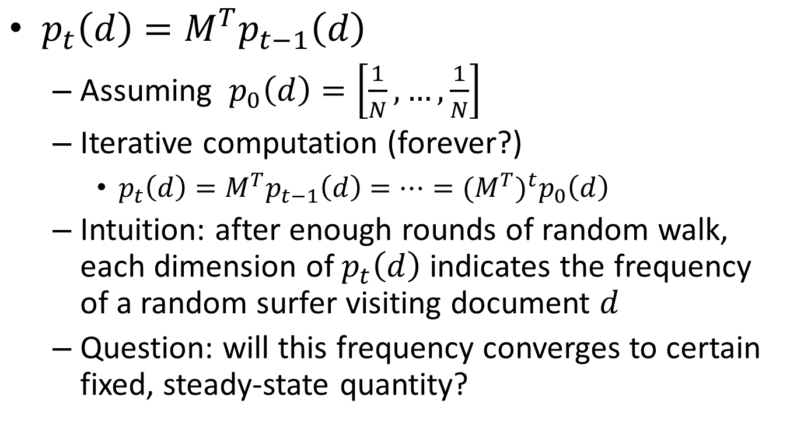
PageRank computation becomes
$p_{t}\left(d\right)=M^{T}p_{t−1}\left(d\right)$
Assuming $p_{0}\left(d\right)=\left[\frac{1}{N},…,\frac{1}{N}\right]$
Iterative computation (forever?)
$p_{t}\left(d\right)=M^{T}p_{t−1}\left(d\right)=…={(M^{T})}^{t}p_{0}\left(d\right)$
Intuition: after enough rounds of random walk, each dimension of $p_{t}\left(d\right)$ indicates the frequency of a random surfer visiting document $d$
Question: will this frequency converges to certain fixed, steady-state quantity?

Slide 30



Stationary distribution of a Markov chain
For a given Markov chain with transition matrix M, its stationary distribution of π is
Necessary condition
Irreducible: a state is reachable from any other state
Aperiodic: states cannot be partitioned such that transitions happened periodically among the partitions
$$∀i∈S, π_{i}≥0$$
$$\sum_{i∈S}{π_{i} }=1$$
A probability vector
$$π=M^{T}π$$
Random walk does not affect its distribution

Slide 31
Markov chain for PageRank
Random jump operation makes PageRank satisfy the necessary conditions
Random jump makes every node is reachable for the other nodes
Random jump breaks potential loop in a sub-network
What does PageRank score really converge to?

Slide 32

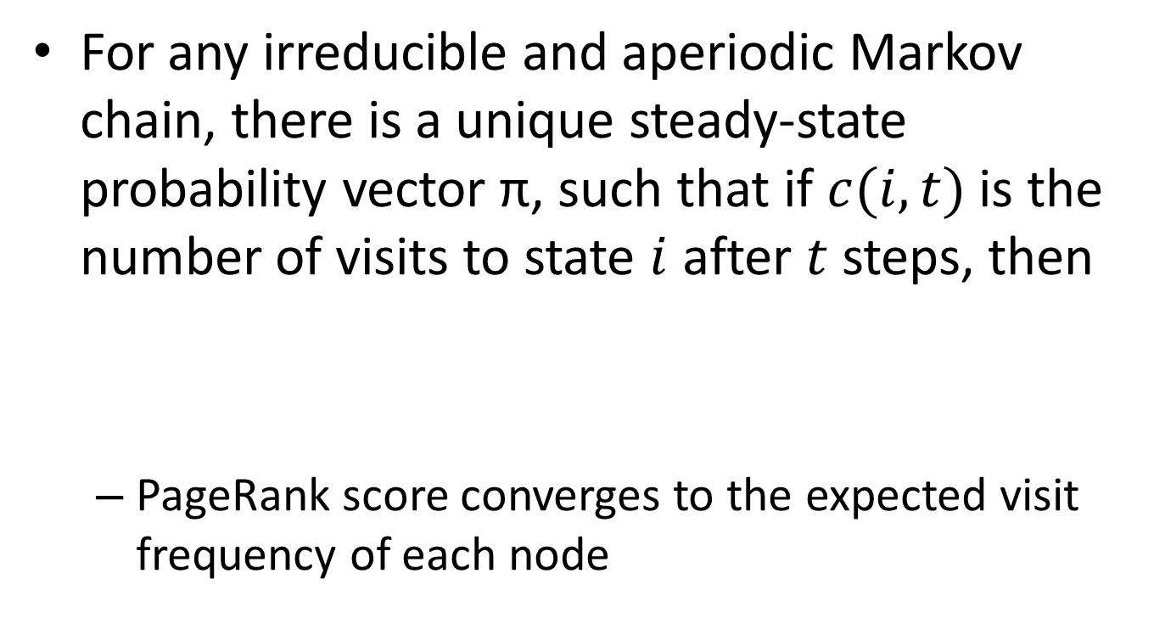
Stationary distribution of PageRank
For any irreducible and aperiodic Markov chain, there is a unique steady-state probability vector π, such that if $c(i,t)$ is the number of visits to state $i$ after $t$ steps, then
PageRank score converges to the expected visit frequency of each node
$$\lim_{t→∞}{\frac{c\left(i,t\right)}{t}}=π_{i}$$

Slide 33

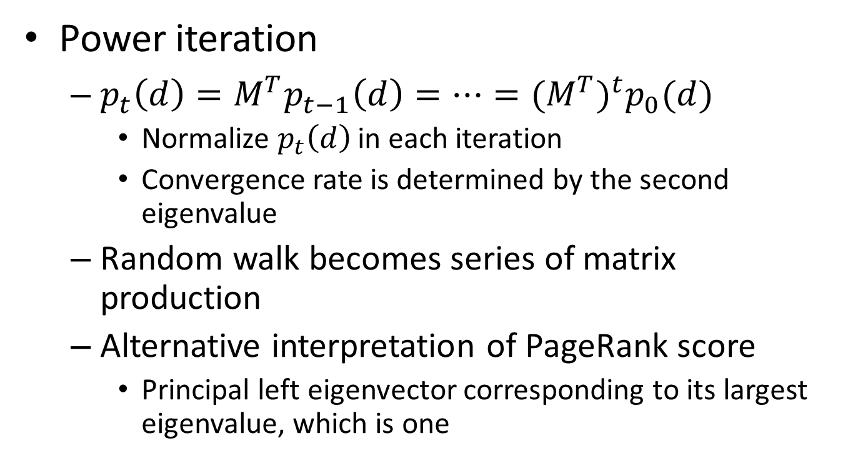
Computation of PageRank
Power iteration
$p_{t}\left(d\right)=M^{T}p_{t−1}\left(d\right)=…={(M^{T})}^{t}p_{0}(d)$
Normalize $p_{t}\left(d\right)$ in each iteration
Convergence rate is determined by the second eigenvalue
Random walk becomes series of matrix production
Alternative interpretation of PageRank score
Principal left eigenvector corresponding to its largest eigenvalue, which is one
$$M^{T}×π=1×π$$

Slide 34
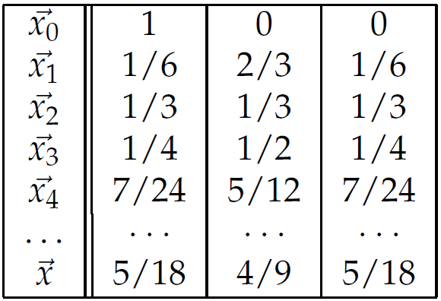

Computation of PageRank
An example from Manning’s text book
$$M=\left(\begin{matrix}1/6 & 2/3 & 1/6 \\ 5/12 & 1/6 & 5/12 \\ 1/6 & 2/3 & 1/6\end{matrix}\right)$$

Slide 35
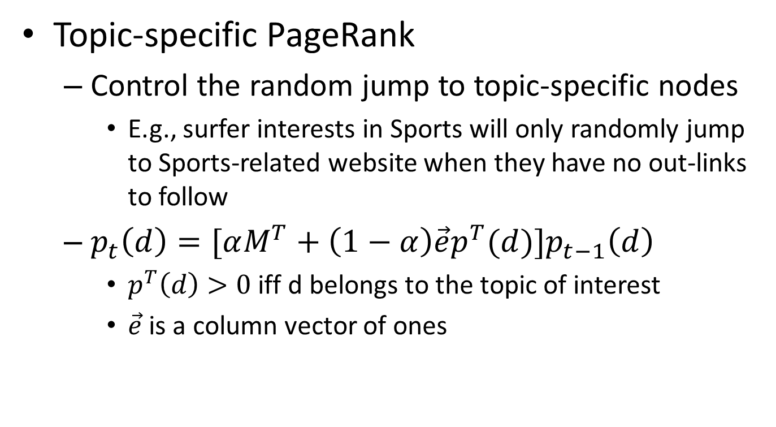
Variants of PageRank
Topic-specific PageRank
Control the random jump to topic-specific nodes
E.g., surfer interests in Sports will only randomly jump to Sports-related website when they have no out-links to follow
$p_{t}\left(d\right)=[αM^{T}+\left(1−α\right){\vec{e}p}^{T}(d){]p}_{t−1}\left(d\right)$
$p^{T}\left(d\right)>0$ iff d belongs to the topic of interest
$\vec{e}$ is a column vector of ones

Slide 36
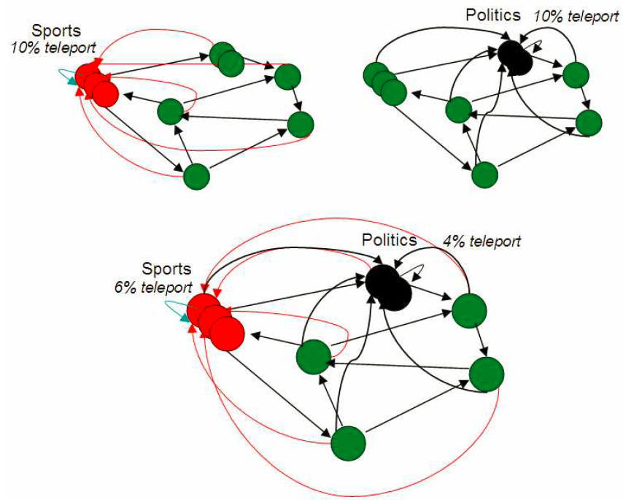
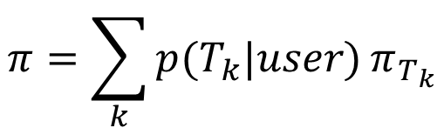
Variants of PageRank
Topic-specific PageRank
A user’s interest is a mixture of topics
Compute it off-line
User’s interest: 60% Sports, 40% politics
Damping factor: 10%
$$π=\sum_{k}{p(T_{k}|user)}π_{T_{k}}$$
Manning, “Introduction to Information Retrieval”, Chapter 21, Figure 21.5

Slide 37
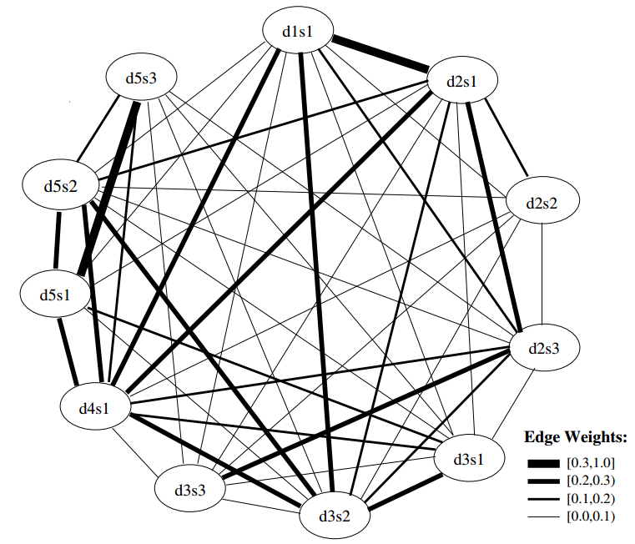
Variants of PageRank
LexRank
A sentence is important if it is similar to other important sentences
PageRank on sentence similarity graph
Centrality-based sentence salience ranking for document summarization
Erkan & Radev, JAIR’04

Slide 38
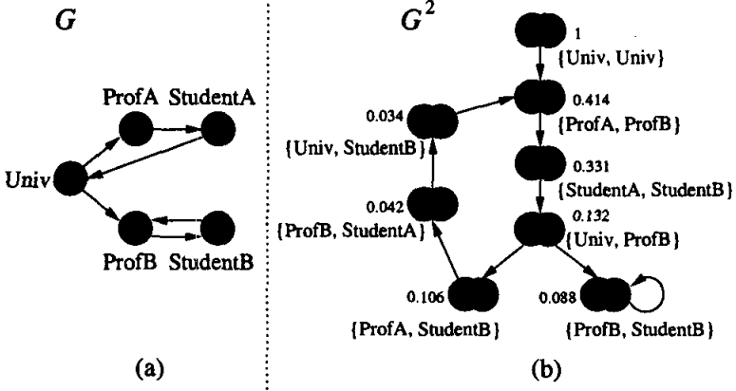
Variants of PageRank
SimRank
Two objects are similar if they are referenced by similar objects
PageRank on bipartite graph of object relations
Measure similarity between objects via their connecting relation
Glen & Widom, KDD'02

Slide 39
HITS algorithm
Two types of web pages for a broad-topic query
Authorities – trustful source of information
UVa-> University of Virginia official site
Hubs – hand-crafted list of links to authority pages for a specific topic
Deep learning -> deep learning reading list

Slide 40
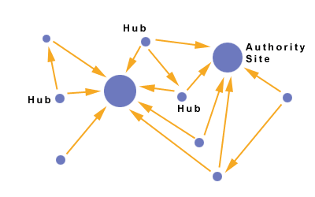
HITS algorithm
HITS=Hyperlink-Induced Topic Search
Intuition
Using hub pages to discover authority pages
Assumption
A good hub page is one that points to many good authorities -> a hub score
A good authority page is one that is pointed to by many good hub pages -> an authority score
Recursive definition indicates iterative algorithm

Slide 41


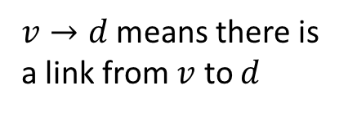

Computation of HITS scores
Two scores for a web page for a given query
Authority score: $a\left(d\right)$
Hub score: $h(d)$
$v→d$ means there is a link from $v$ to $d$
$$a\left(d\right)←\sum_{v→d}{h(v)}$$
$$h\left(d\right)←\sum_{d→v}{a(v)}$$
Important HITS scores are query-dependent!
With proper normalization (L₂-norm)

Slide 42



Computation of HITS scores
In matrix form
$\vec{a}←A^{T}\vec{h}$and $\vec{h}←A\vec{a}$
That is $\vec{a}←A^{T}A\vec{a}$and $\vec{h}←AA^{T}\vec{h}$
Another eigen-system
$$\vec{a}=\frac{1}{λ_{a}}A^{T}A\vec{a}$$
Power iteration is applicable here as well
$$\vec{h}=\frac{1}{λ_{h}}AA^{T}\vec{h}$$

Slide 43
Constructing the adjacent matrix
Only consider a subset of the Web
For a given query, retrieve all the documents containing the query (or top K documents in a ranked list) – root set
Expand the root set by adding pages either linking to a page in the root set, or being linked to by a page in the root set – base set
Build adjacent matrix of pages in the base set

Slide 44
Constructing the adjacent matrix
Reasons behind the construction steps
Reduce the computation cost
A good authority page may not contain the query text
The expansion of root set might introduce good hubs and authorities into the sub-network

Slide 45
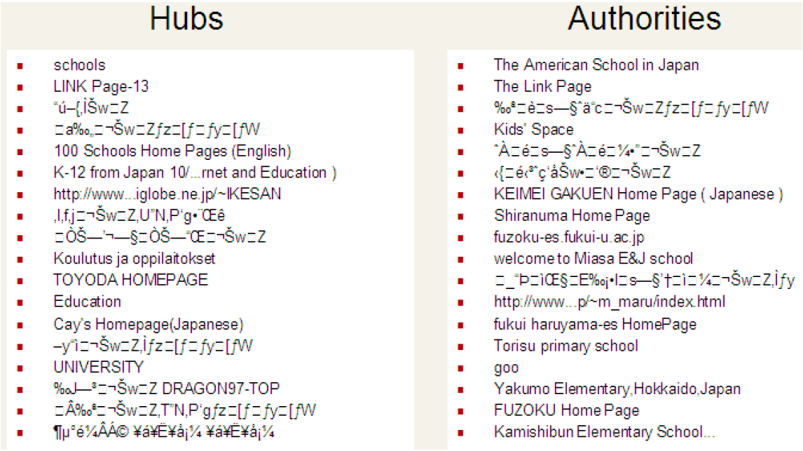
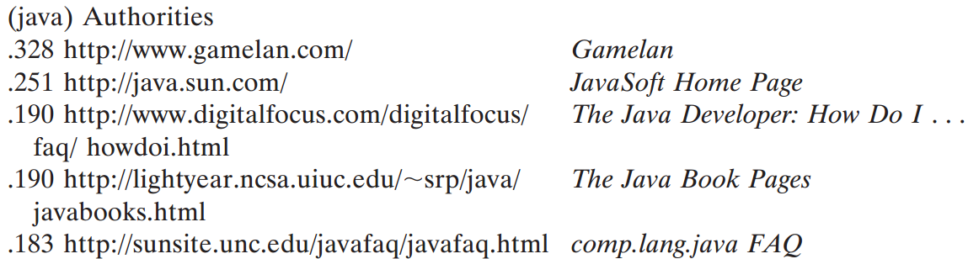
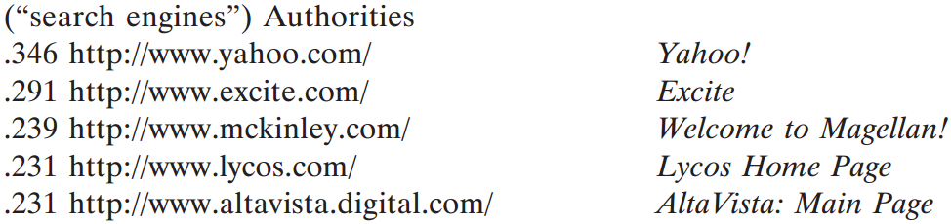
Sample results
Kleinberg, JACM'99
Manning, “Introduction to Information Retrieval”, Chapter 21, Figure 21.6

Slide 46
Today’s reading
Introduction to information retrieval
Chapter 21: Link Analysis

Slide 47
References
Page, Lawrence, Sergey Brin, Rajeev Motwani, and Terry Winograd. "The PageRank citation ranking: Bringing order to the web." (1999)
Haveliwala, Taher H. "Topic-sensitive pagerank." In Proceedings of the 11th international conference on World Wide Web, pp. 517-526. ACM, 2002.
Erkan, Günes, and Dragomir R. Radev. "LexRank: Graph-based lexical centrality as salience in text summarization." J. Artif. Intell. Res.(JAIR) 22, no. 1 (2004): 457-479.
Jeh, Glen, and Jennifer Widom. "SimRank: a measure of structural-context similarity." In Proceedings of the eighth ACM SIGKDD international conference on Knowledge discovery and data mining, pp. 538-543. ACM, 2002.
Kleinberg, Jon M. "Authoritative sources in a hyperlinked environment." Journal of the ACM (JACM) 46, no. 5 (1999): 604-632.

